Slide 1
SRIP TASK-1
NEHAA SHRI MS
22BCE1225
(first part of the task)

Slide 2
Problem in hand
Given a paragraph P, and a question q ( assume that the answer for the question q is in P), to label the questions as either open-question or closed-question. Here, by closed-question, we mean that, there is only one , unique answer for q. For the open-question q, there will be more than one answer for q. After labelling,the system should compute the answer for q.

Slide 3
Preliminary analysis
Given task involves text classification and generation.
Text based classification may require us to come up with word embeddings that capture contextual meaning of each word in a sentence.
Deep learning methods would be much more effective in dealing with text classification when compared to Machine learning methods since word embeddings made from a pre trained DL model would capture more meaning and can be made more effective by fine tuning the hyperparameters of the model.

Slide 4
Constraints Faced
Lack of research papers specific to use case.More research carried out in the domain of classifying closed type questions.
Lack of a comprehensive dataset
Lack of computational power and resources-limited access to GPUs

Slide 5
Reference used
https://www.ncbi.nlm.nih.gov/pmc/articles/PMC8356656/
The above article does a comparative analysis of several ML and DL techniques to classify various types of closed questions from a Turkish Dataset(inspired from UIUC dataset)

Slide 6
Reference used(contd)-Motivation behind the paper
Implementation of a question-answering system-using NLP to identifying the category of sort questions that are asked; predict the form of precise response according to the query;
Major challenge- generating features from a single question is more difficult than generating features from a large text

Slide 7
3a. Unique Linguistic Features: Turkish, as a non-Indo-European language, lacks grammatical gender and noun classes, making it challenging for traditional NLP techniques designed for Indo-European languages like English and German. Additionally, Turkish exhibits complex word formations through derivative affixes and inflectional suffixes, resulting in a multitude of word structures derived from a single verbal root.
3b. Importance of Lemmatization: Due to the intricate structure of Turkish and the prevalence of inflectional and derivational suffixes, lemmatization becomes crucial for obtaining uninflected word forms essential for tasks like information retrieval (IR). Lemmatization aims to reduce words to their root forms, facilitating the connection between surface forms and dictionary forms.
3c. Lack of Resources: Turkish text processing faces challenges due to the scarcity of tools and datasets tailored to the language. Despite the difficulties, efforts to address these challenges, such as converting English question datasets into Turkish, demonstrate a proactive approach to leveraging existing resources for Turkish NLP research.

Slide 8
APPROACHES USED
Distributed representations of words or Word2vec- the concept behind the word representation approach is the terms with a semantic or syntactic connection which is used with higher probability in a similar context .
CBOW-
Skipgrams

Slide 9
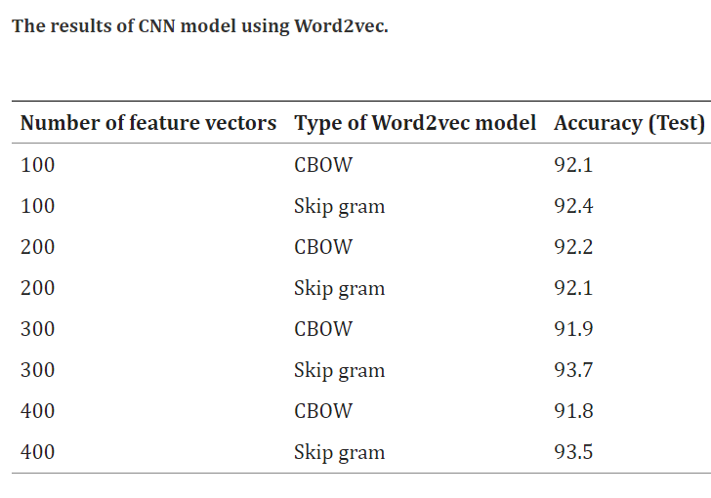
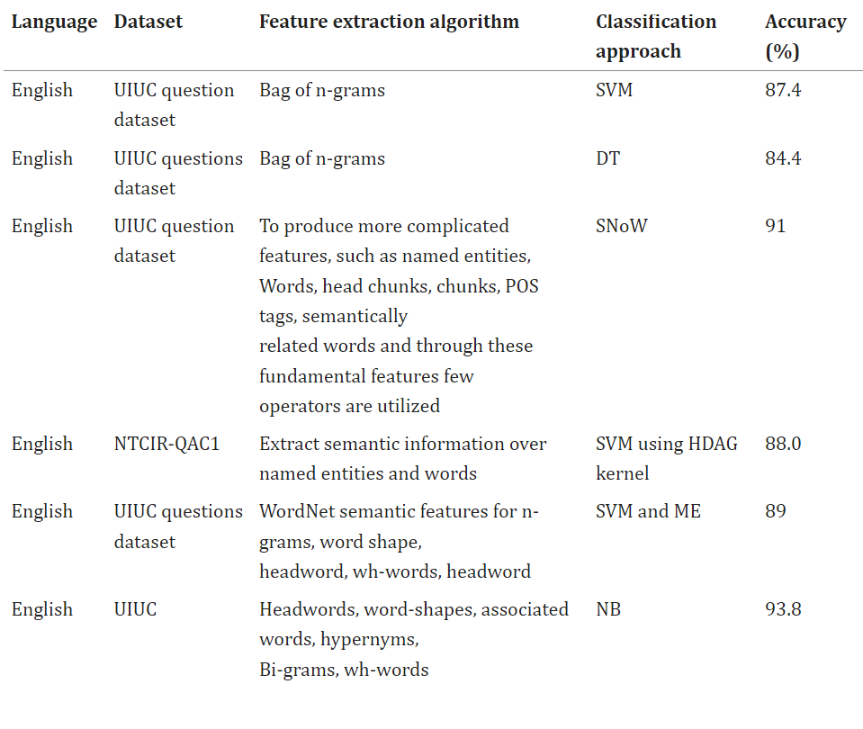
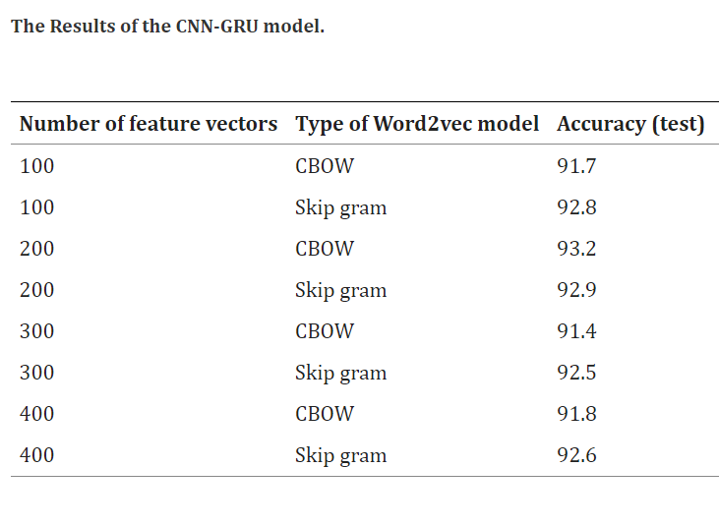
APPROACHES USED

Slide 10
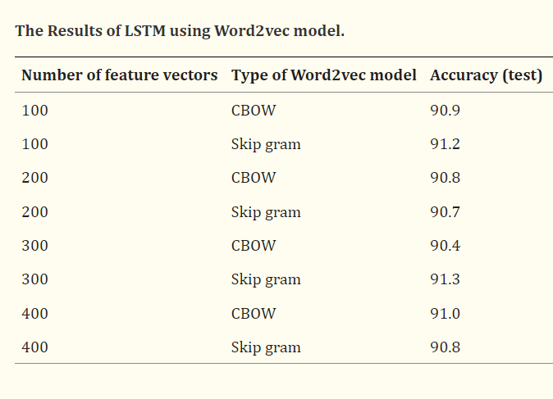
APPROACHES USED

Slide 11
My approach
I decided to study both the word embedding algorithms provided by Word2Vec and explored CNN-GRU approach for classifying questions.

Slide 12
Description of dataset
I curated a new datasets from these datasets
UIUC dataset
https://huggingface.co/datasets/launch/open_question_type
https://github.com/amazon-science/mintaka

Slide 13
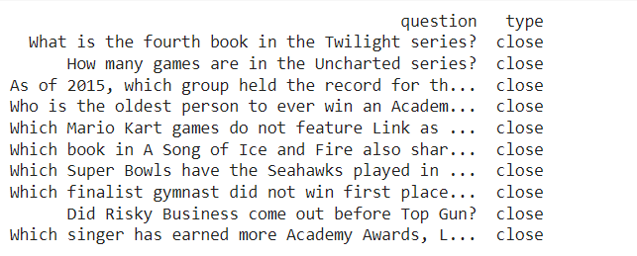
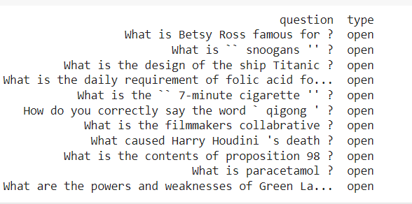
DESCRIPTION OF DATASET
Total number of questions:450(including open and close)

Slide 14
DATA CLEANING
I used NLTK library and regex library for the following to make efficient use of computational resources for the task:-
Removing stopwords(excluding words that a question starts with like why/what/could/would/how/when/who
Removing Non-ASCII words
Converting all the words to lowercase characters
Stemming words
Lemmatizing verbs

Slide 15
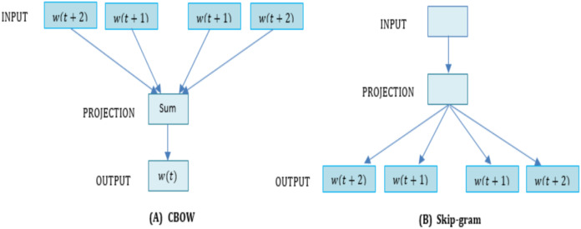
DATA PREPROCESSING-Word2Vec

Slide 16
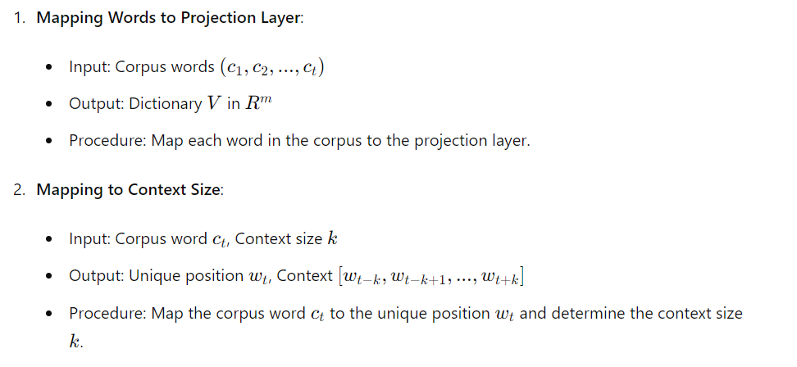
CBOW-Continuous Bag of Words

Slide 17
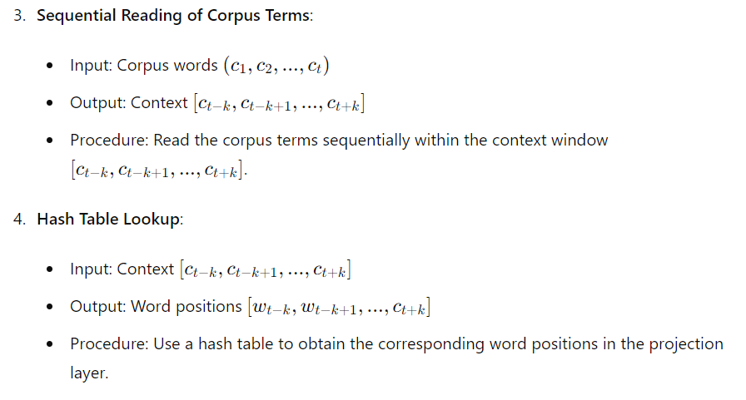

Slide 18
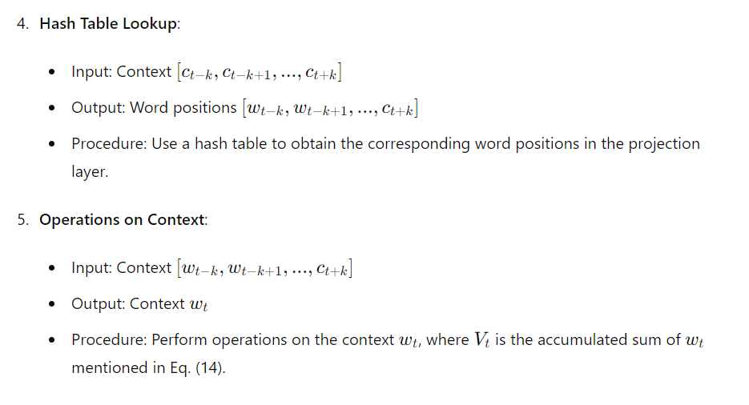

Slide 19
Implementation
cleanedData consists of all the stemmed and lemmatized questions
Using Keras Tokenizer we implement tokenization and vocabulary building;we then generate context-word pairs
CBOW Architecture
The CBOW model is constructed using a Sequential model in Keras.
It includes an Embedding layer to map word IDs to dense vectors, followed by a
Lambda layer to compute the mean of the context word vectors.
Finally, a Dense softmax layer is added to predict the target word based on the context

Slide 20
Training Model
For each epoch(a total of 6 epochs), it iterates through the pairs and updates the model weights using the RMSprop optimizer.
After training,word embeddings are extracted from model.

Slide 21
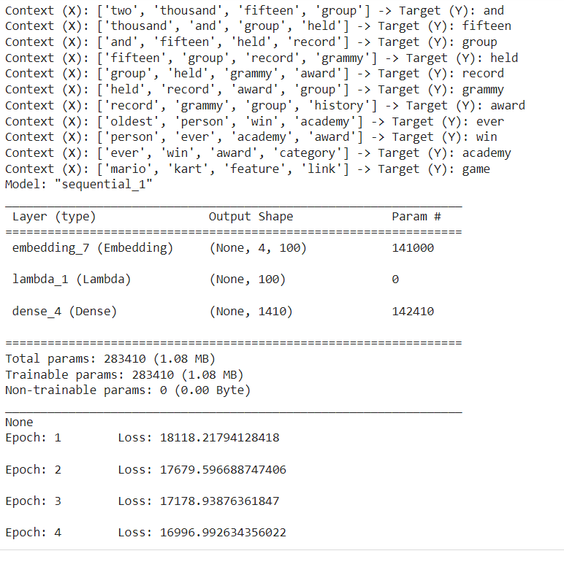

Slide 22
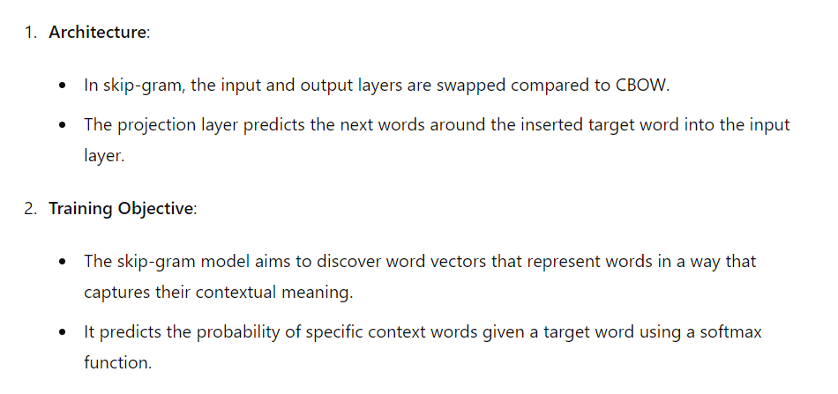
SKIPGRAM

Slide 23
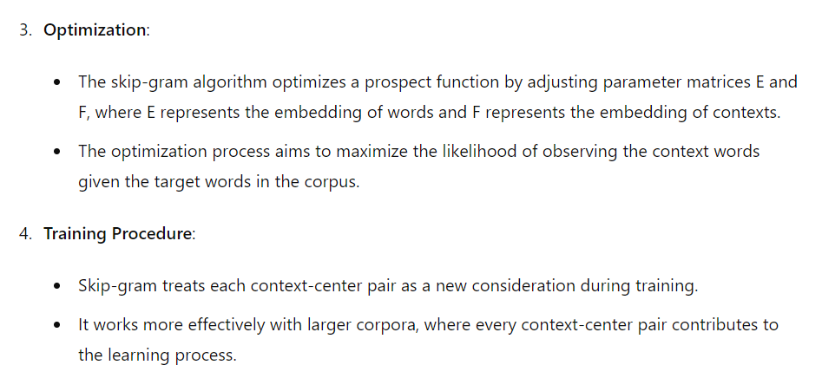

Slide 24
Implementation
1. Tokenization and Vocabulary Building:
- Tokenization is performed on the text corpus to convert text into a sequence of words.
- The Tokenizer class from Keras is used to tokenize the text and build a vocabulary of unique words.
2. Skip-grams Generation:
- Skip-grams are generated from the tokenized text corpus using the skipgrams function from Keras.
- Skip-grams are pairs of a target word and its context words within a specified window size.

Slide 25
3. Skip-gram Architecture:
- The skip-gram architecture consists of two embedding layers: one for the target words and one for the context words.
- Each word is represented as a dense vector of a fixed size (embed_size).
- The dot product of the embeddings of the target and context words is computed to predict the relevance between them.
- The model is trained to maximize the probability of observing context words given a target word.
4. Training Procedure:
- The model is trained using the skip-grams generated from the corpus.
- For each skip-gram pair, the model predicts the relevance between the target and context words.
- The model is optimized using the RMSprop optimizer and binary cross-entropy loss function.
- Training is performed over multiple epochs, with each epoch iterating through all the skip-gram pairs in the corpus.

Slide 26
5. Word Embeddings:
- After training, word embeddings are obtained from the model.
- The word embeddings capture semantic similarities between words based on their contextual usage in the corpus.
- These word embeddings can be used for various natural language processing tasks, such as word similarity calculation and text classification.

Slide 27
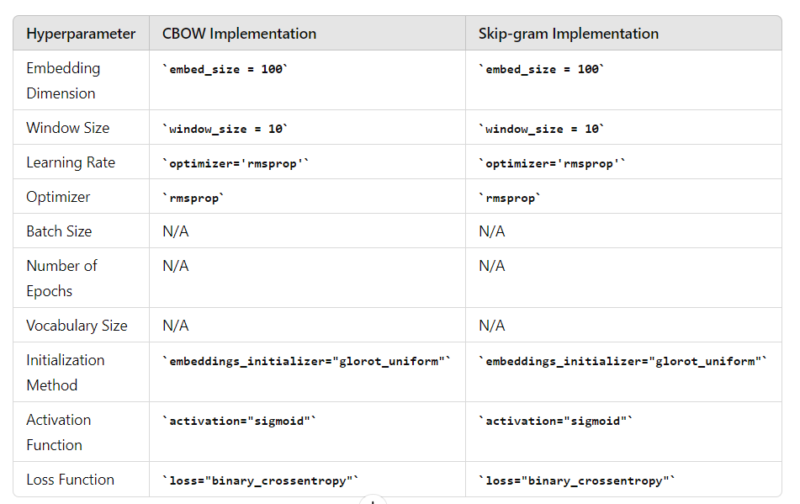
HYPER-PARAMETERS

Slide 28
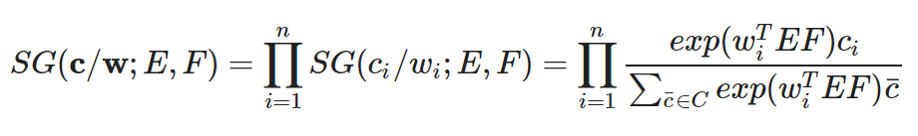
PROSPECT FUNCTION-Optimizing this is the key
A higher dot product (WEF) between the word embeddings indicates a stronger semantic relationship between the
context and target words. The prospect function with the exponential term amplifies this score.
Finally, the sigmoid function transforms the amplified score into a probability between 0 (unlikely) and 1 (highly likely)
that the context word appears near the target word.
By maximizing the probability of actual context words and minimizing the probability of random (negative sample)
words, the skip-gram model adjusts the word embeddings during training. This process helps the model capture
semantic relationships between words in the vocabulary.

Slide 29
GENSIM
We can also use GENSIM library to directly obtained a pre trained word2vec model from which we can get word embeddings.
Along with word embeddings we can also use genism for finding out most similar words,word analogies and euclidiean distances between two word vectors.

Slide 30
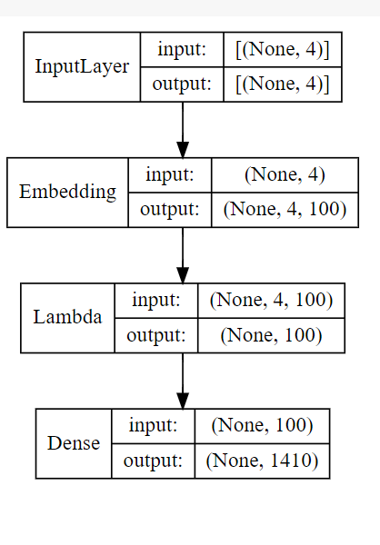
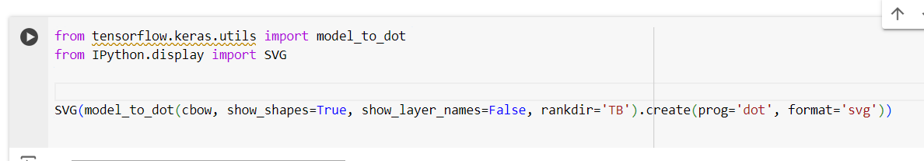

Slide 31
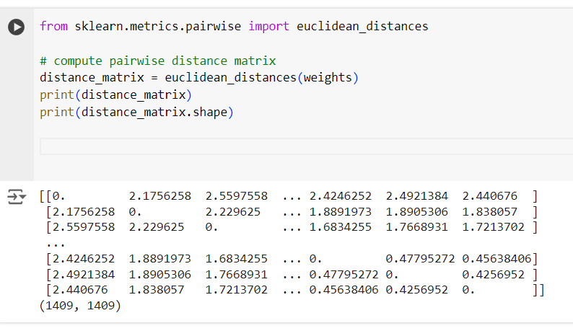

Slide 32
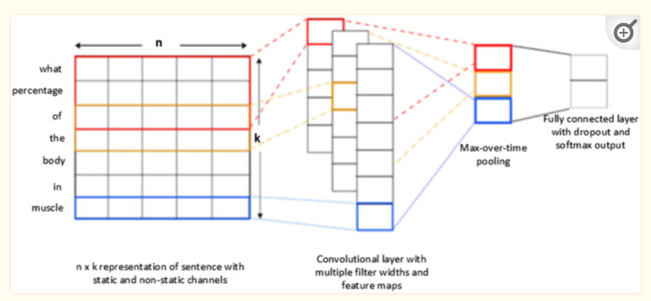
DEEP LEARNING MODEL-CNN GRU
CNN
CNN consists of three major layers as convolution layer, Max-pooling layer, and fully connected layer for question classification.
The Convolutional layer is an essential layer of a CNN model that performs several computational processes.
The max-pooling layer, in CNN, performs on data to compress and make it smooth. While for selecting the maximum value of the responsive area the Max-layer is used which produces data-invariant small translational changes
A fully connected layer is used as a final layer of CNN which produces the output by connecting all neurons in the forward and backward manner.

Slide 33
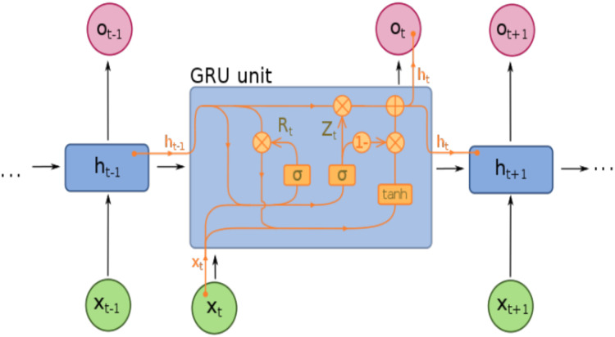
GRU
GRUs are capable of processing sequential data, such as text or time series data, by learning from past information and using it to inform predictions about future elements

Slide 34
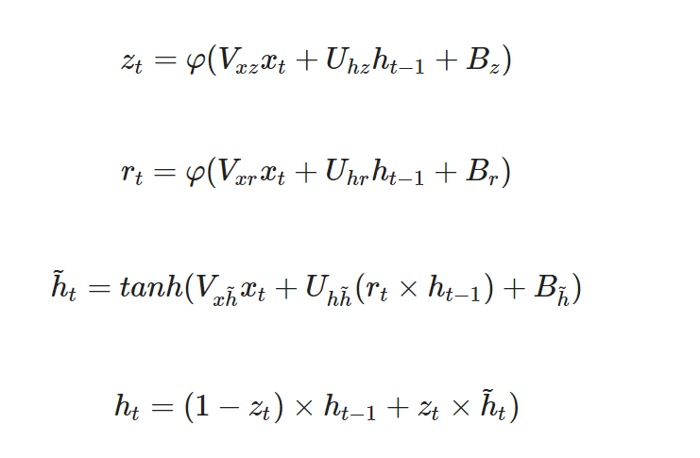
Vxz, Vxr and Vxh~ refer to the weight matrix among the input layer and update gate, reset gate, and candidate state
recurrent connection weight matrix is represented by Uhz, Uhr and Uhh~
xtis the time series sample input and hidden output is denoted by ht.
φ is the sigmoid activation function of update and reset gates, * performs element-wise multiplication operation
Bz, Br and Bh~ are the corresponding biases

Slide 35
Input (Xt-1, Xt, Xt+1): These represent the input vectors at the current timestep (t) and the previous timestep (t-1)
as well as the next timestep (t+1).
Hidden State (ht-1): This represents the hidden state vector at the previous timestep, which captures information
about the past sequence elements.
Update Gate (Z): This gate controls how much of the previous hidden state information (ht-1) to keep.
It uses a sigmoid function (σ) to output a value between 0 and 1. A value closer to 1 indicates keeping more
information, while a value closer to 0 indicates discarding more information.
Reset Gate (R): This gate determines how much of the past information to forget and how much new information
to incorporate from the current input (Xt). It also uses a sigmoid function (σ) to output a value between 0 and 1.
Candidate Hidden State (ht^~): This vector represents the candidate for the new hidden state based on the current
input (Xt) and the filtered previous hidden state (σ(Z)*ht-1).
tanh: This is the hyperbolic tangent activation function, often used in RNNs. It introduces non-linearity into the
network, allowing it to learn more complex patterns.
Output Hidden State (ht): This is the actual new hidden state, obtained by combining the candidate hidden state
(ht^~) with the previous hidden state (ht-1), scaled by the reset gate (R

Slide 36
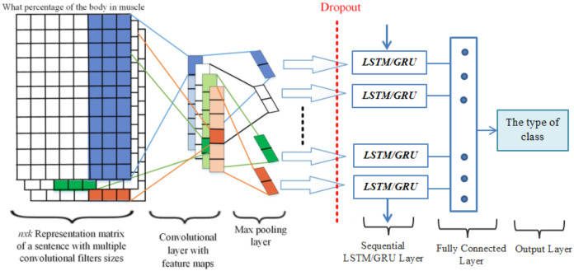
PROPOSED METHODOLOGY-CNN WITH GRU

Slide 37
The word embedding method is applied to convert input text into numerical word vectors to translate into CNN models.
In this way, several convolution kernels of various dimensions were used to capture more helpful features in question classification.
With this technique, CNN preserves the temporal data and generates a single value using the max-pooling layer.
Similarly, the RNN layer is utilized to obtain the temporal features at the input level and captures long-term dependencies.
In word embedding, every question was illustrated as a word embedding matrix to create a classifier using a CNN.
Provided a question consisting n words v1,v2,v3,…vn each word with its pre-trained d-dimension word embedding matrix is swapped, and
stacked row-wise to produce occurrence matrices Vi∈Rn×d. Moreover, in this study, we trained the hyperparameters using
ReLU in the deep learning approaches.

Slide 38

BRIEF IMPLEMENTATION
INPUT LAYER
Let describe the total number of unique words with w1, w2, w3,…, wn in the dictionary D = d1,d2,d3,…dm.
To identify the questions, the Word2vec model is used to translate any word in the query into a particular vector with one of the fixed sizes
of 100, 200, 300 or 400. Every question j is presented with a two-dimensional n×k matrix cj = [v1,v2,…, vn], the description of k refers to the
dimensionality of the vi embedding and a large number of words is denoted by n. To provide the same length for all questions the input
layer transmits data samples as a sequence of unique indices of similar dimensions. i
CNN LAYER
Let’s considered the h words at time t with weight matrices w of dimension w∈Rh×m to perform the following convolutional computation:
f refers to the non-linear Relu activation function and the feature map generated to represented by ci∈Rn−h+1 with h words every time frequently, while bias term denoted by bi.

Slide 39
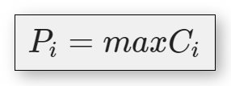
After that, the max-pooling layer performs to receive created features from convolution which change the features map into its maximum activation value.
After performing the max-pooling operations, we combined the features from various levels of convolution layers to achieve the final multilevel feature combination output
FEATURE MAPPING OF CNN LAYER WITH RNN LAYER
Each input has a vector series, which scans it with a fixed filter distance. In this technique, the filter sizes of 3, 4, and 5 are used to carry the features of words.
the output generated by CNN’s layers are further processed as inputs to the RNNs layers passing through the gating mechanism for learning the high informative features. Furthermore, in order to classify questions every layer processes different features in a question with the Relu activation function in the feature map.

Slide 40
RNN LAYER
The recurrent layer has the capability to capture the long-term dependencies; therefore we feed original word embedding as an input to the RNN layer instead of those features generated by CNN. The purpose of selecting the RNN layers approach is to take the sequence data through utilizing the previous information. In these RNN layers, the final output of the layers has the equivalent number of units.
Due to sequence data, the RNN layers can learn temporal features from it. After this, we performed a different combination of CNN and RNN acquired features to carry out question classification. Based on this technique, sequential features should be perfectly maintained and a sequence created by max-pool layer instead of a single value. According to the following process, the data are fed into an RNN layer with many to one mechanism and a fully connected layer with softmax output.

Slide 41
HOW DID WE IMPLEMENT THIS MODEL?
Tokenization: The code uses Tokenizer from Keras to convert text into sequences of integer indices,
representing each word with a unique ID
based on its frequency in the corpus.
Padding: Sequences are padded with zeros to ensure a uniform length (MAX_LENGTH) for all inputs.
Word Embeddings: The code utilizes pre-trained word vectors (word2vec) to represent words as numerical
vectors. It loads these vectors from a file and creates an embedding matrix where each row represents the
vector for a word in the vocabulary.
Model Building:
Embedding Layer: The model uses a pre-trained embedding layer (Embedding) to map integer-encoded
words to their corresponding word vectors in the embedding matrix. This layer is typically frozen (not trained)
since the word vectors are pre-trained.
GRU Layers: The model uses two Gated Recurrent Unit (GRU) layers to process the sequence of word
vectors. GRUs are a type of recurrent neural network (RNN) capable of capturing sequential information in
text data.

Slide 42
Attention Layer: The code defines a custom __attention3DBlock__ function that implements an attention mechanism. Attention allows the model
to focus on specific parts of the input sequence that are most relevant for the sentiment classification task.
Dense Layer: A final dense layer with a softmax activation function predicts the sentiment category (positive or negative) for each input text.
Training and Evaluation:
Model Compilation: The code compiles the model by specifying the loss function (categorical crossentropy for multi-class classification), optimizer (Adam), and metrics (accuracy) to be used during training.
Training: The model is trained on the training data for a specified number of epochs (6 iterations).
Evaluation: The model's performance is evaluated on the validation and testing sets using the compiled metrics (accuracy).

Slide 43
HYPERPARAMETERS THAT CAN BE FINE TUNED TO INCREASED ACCURACY
Data Preprocessing:
Maximum Sequence Length (MAX_LENGTH): This parameter defines the maximum number of words considered for each text sample. Sequences shorter than
this value will be padded with zeros, while longer sequences will be truncated.
Word Embeddings:
Embedding Dimension (EMBEDDING_DIM): This determines the dimensionality of the word vectors used to represent words. Higher dimensions
might capture more semantic information but require more training data and computational resources.
Model Architecture:
Number of Hidden Units (n_x): This controls the complexity of the GRU layers, where a higher number of units allows for capturing more intricate relationships
between words.
Dropout Rate (dropout, recurrent_dropout): Dropout helps prevent overfitting by randomly dropping a certain percentage of units during training.
Attention Mechanism (SINGLE_ATTENTION_VECTOR): This flag determines how the attention mechanism focuses on specific parts of the sequence.
Experimenting with this setting might affect how the model attends to relevant words in the text.

Slide 44
Training:
Batch Size: This defines the number of samples processed simultaneously during training. A larger batch size can improve training speed but might require more memory.
Number of Epochs (epochs): This specifies the number of times the entire training dataset is passed through the model for learning. You might need to adjust this based on the complexity of the model and dataset.
Learning Rate: This hyperparameter controls how much the model's weights are updated based on errors during training. A higher learning rate can lead to faster learning but might cause instability, while a lower rate can be slower to converge.
Momentum: This parameter helps the optimizer accelerate convergence by considering the direction of previous weight updates. Adjusting momentum can influence the training speed.
L2 Regularization: This technique penalizes large weights in the model, reducing overfitting. You can adjust the regularization weight to control this effect.
Other Adjustable Settings:
Optimizer: The code uses Adam, but you could explore other optimizers like RMSprop or SGD with their corresponding hyperparameters.
Loss Function: While categorical crossentropy is suitable for multi-class classification, depending on your specific task, you might consider alternative loss functions.
Activation Functions: The code uses tanh for GRU layers and softmax for the output layer. You could experiment with other activation functions for different layers to explore their impact on performance.
Early Stopping: Implement early stopping to halt training if validation performance doesn't improve for a certain number of epochs to prevent overfitting.
Learning Rate Schedule: Consider a learning rate schedule that dynamically adjusts the learning rate during training (e.g., decay over time) to potentially improve convergence.
By adjusting these settings, you can fine-tune the model's architecture, training process, and potentially enhance its performance on your sentiment analysis task. It's important to experiment and evaluate different configurations to find the optimal settings for your specific dataset.

Slide 45
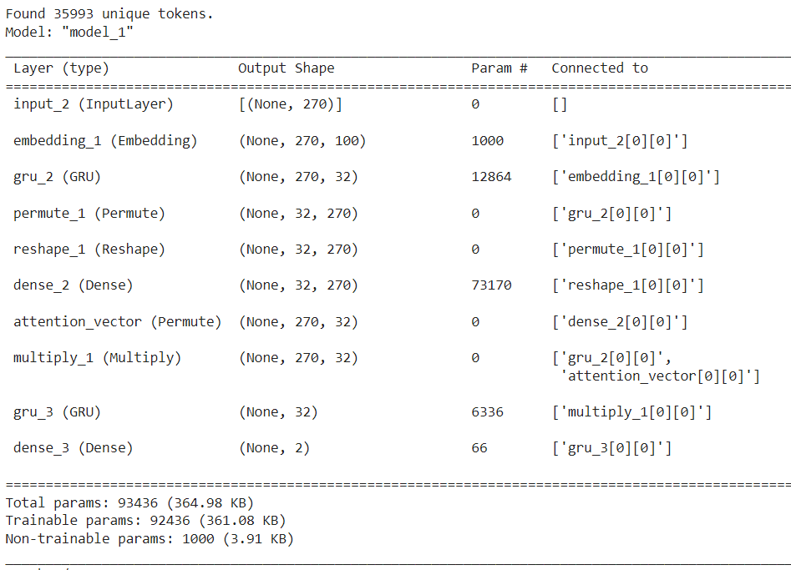
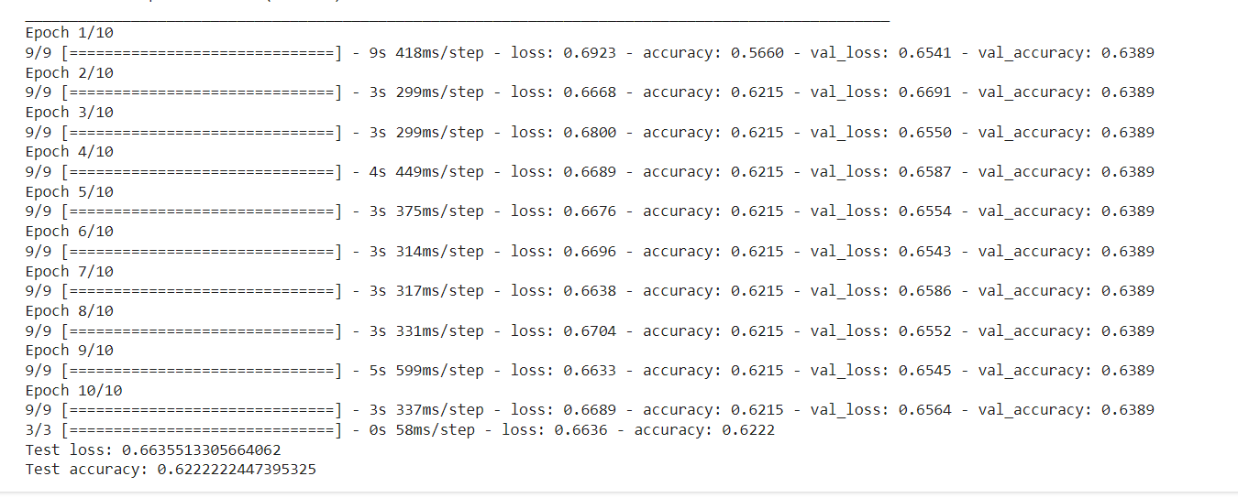

Slide 46
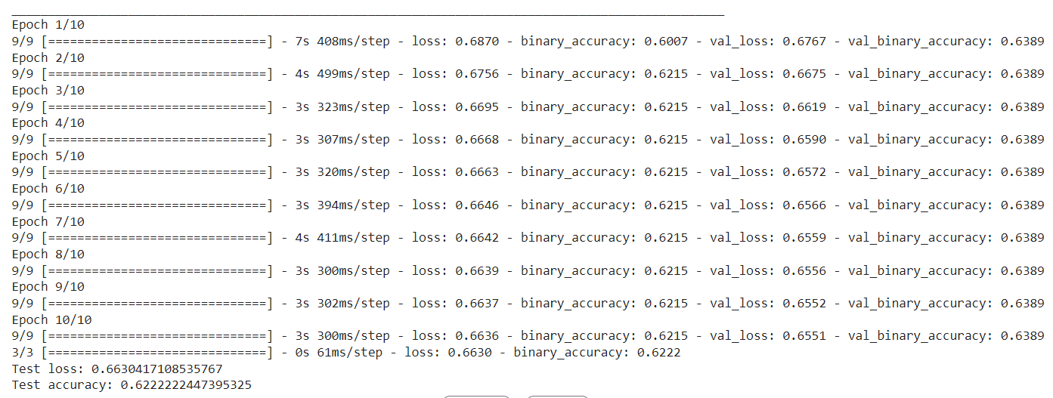
Changing the hyperparameters for improved accuracy
Using SGD with momentum as optimizer and loss function as BinaryCross Entropy

Slide 47
INFERENCES:Reasons for reduced accuracy
1)Lack of a large dataset:-
1a.High Variance:There is always going to be a trade off between variance and bias.With a small dataset.With a small dataset, the model has limited information to learn the true underlying distribution of the data. This can lead to high variance, where the model's predictions can vary significantly with small changes to the training data. CNN-GRUs, being complex models with many parameters, tend to have higher capacity and can fit the training data very well. This can lead to low bias on the training set.
1b. Overfitting and Effective Number of Parameters: For a CNN-GRU, the number of effective parameters can be much larger than the number of explicitly defined weights and biases. This is because the effective number of parameters considers the interaction between parameters. With a small dataset, there isn't enough data to constrain the learning of such a large number of effective parameters, leading to overfitting and poor generalization on unseen data.
1c.Optimisation and Local minima of loss func:With a small dataset, the loss function landscape can be noisy and have many local minima. These local minima may not represent the true minimum representing the best fit for the underlying data distribution. The optimization algorithm can easily get stuck in such local minima, leading to sub-optimal performance.

Slide 48
2. Difficulty Capturing Long-Range Dependencies:
While CNNs are good at capturing local patterns in data and GRUs are designed to handle sequential data, a CNN-GRU combination might not be the most effective architecture for capturing long-range dependencies between words in a sentence, which can be important for question classification.
Mathematical Formulation: Capturing long-range dependencies requires the model to learn weights that correspond to these long-range relationships between words. In CNNs, the receptive field of a filter limits the size of the context a filter can consider. In GRUs, the gradients for long-range dependencies can vanish over time due to the recurrent nature of the architecture.
Impact on Accuracy: If the questions in your dataset rely heavily on long-range dependencies between words to determine if they are open ended or closed ended, a CNN-GRU model might not have the capability to learn these relationships effectively, leading to lower accuracy.

Slide 49
3.Vanishing/Exploding Gradients:
During training in CNN-GRUs, gradients are backpropagated through the network to update the weights and biases of the model. If the gradients become too small (vanishing gradients) or too large (exploding gradients) during this process, the weights and biases cannot be updated effectively.
Vanishing Gradients: This can occur in CNNs with deep architectures or in GRUs. In CNNs, with increasing depth, the gradients can become very small as they are multiplied by weight matrices numerous times during backpropagation. In GRUs, vanishing gradients can occur because of the recurrent nature of the architecture.
Mathematical Analysis: The vanishing gradient problem can be analyzed using eigenvalue decomposition of the weight matrices in the network. If the eigenvalues of these weight matrices are less than 1, the gradients will shrink exponentially as they are backpropagated through the network.

